Slide 1

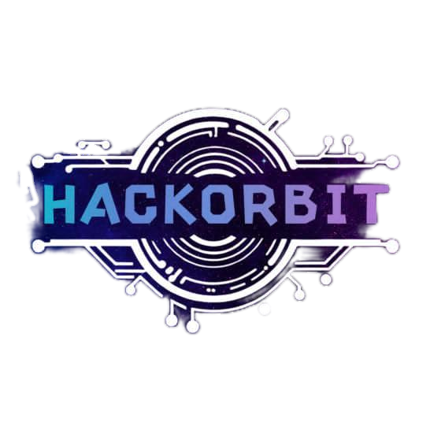


HackOrbit 2025
Neuromatics

Slide 2

THEME & PROBLEM STATEMENT
Healthcare Technology
MindCare: A Mental Health Companion - “Care for your mind,Anytime,Anywhere.”

Slide 3
Proposed Solution:
MindCare is a personal, AI-driven mental health companion designed to be user-friendly, accessible, and personalized for individuals seeking to improve their mental well-being. It is available as a desktop and web-based platform focusing on simplicity, affordability, and offline functionality, ensuring accessibility regardless of the user’s technical proficiency or internet availability.
The solution leverages Natural Language Processing (NLP) and AI to provide personalized support while maintaining user privacy and ease of use. By integrating mental health support tools into a single platform, MindCare aims to encourage self-care practices, enhance emotional awareness, and serve as a trusted, private companion for mental well-being anytime, anywhere.

Slide 4
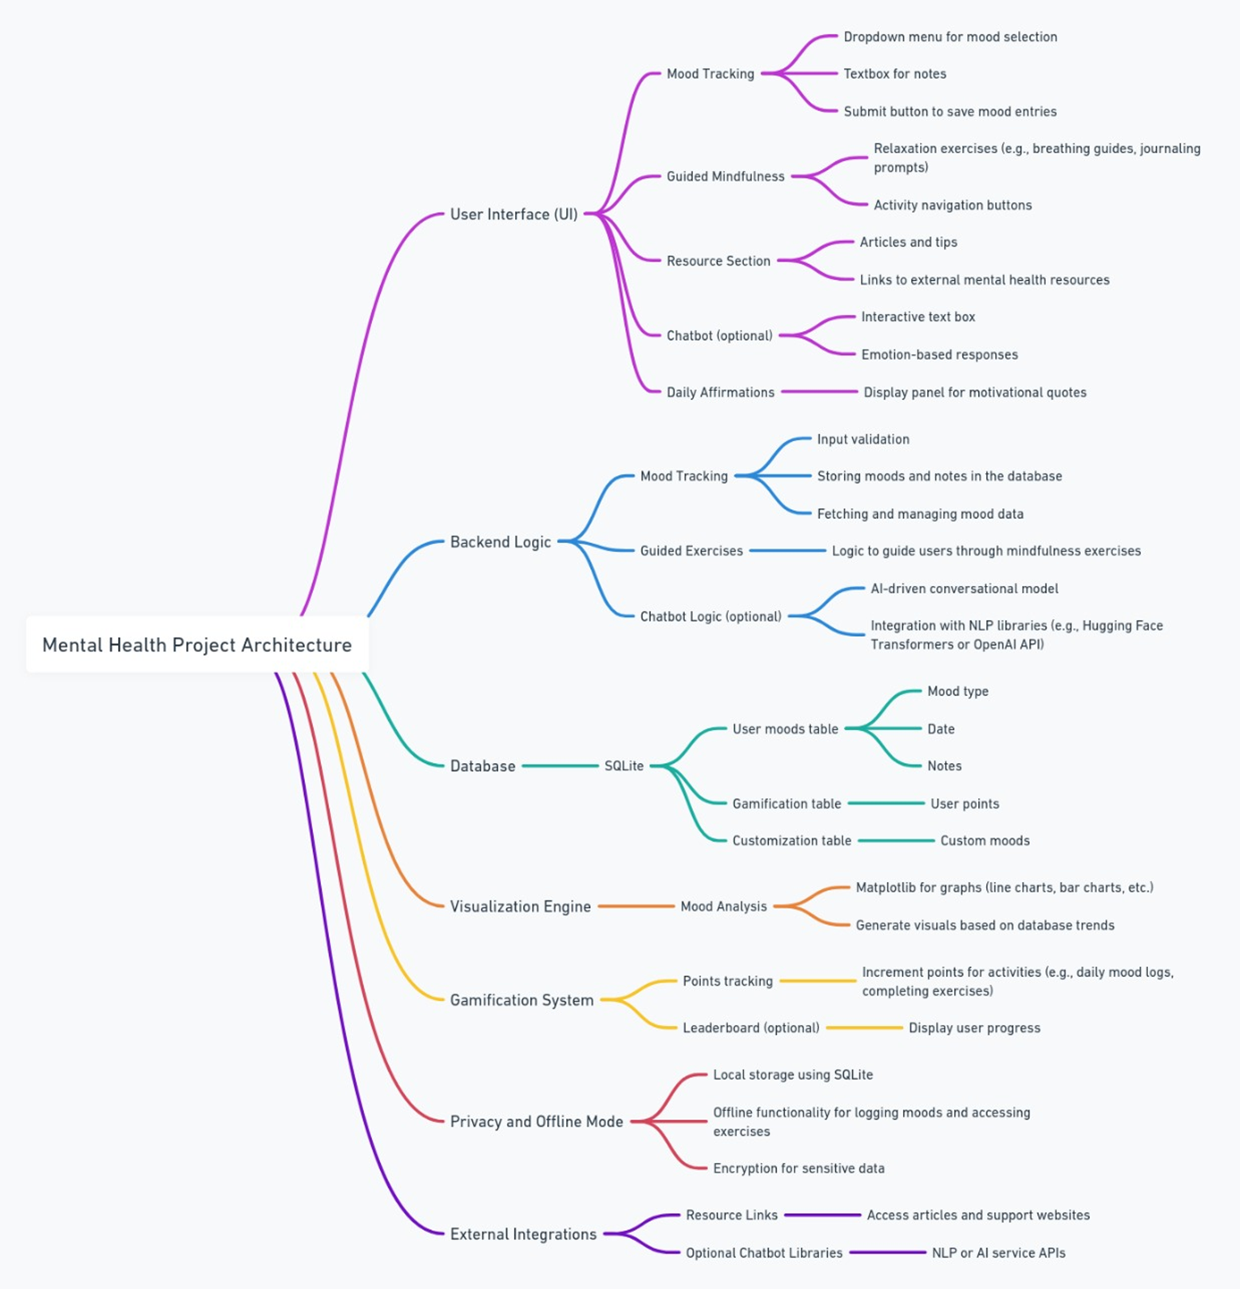

Slide 5
User Interface: Mood tracking, mindfulness guides, chatbot, resources, affirmations. Clean, intuitive design for easy daily use.
Backend Logic: Validates input, manages mood data, guides exercises, chatbot NLP. Handles real-time analysis for personalized feedback.
Database (SQLite): Stores moods, notes, points for gamification, custom moods. Lightweight and efficient for offline-first architecture.
Visualization Engine: Generates charts to visualize mood trends. Provides insights for self-awareness and progress tracking.
Gamification: Tracks points, optional leaderboard to boost engagement. Encourages habit formation through rewards.
Privacy & Offline Mode: Local storage, offline access, secure encrypted data. Ensures user privacy and data ownership.
External Integrations: Resource links, optional chatbot APIs for enhanced support. Enables scalability with third-party mental health tools.

Slide 6
FEATURES AND NOVELTY
Core Features:
Daily Mood Tracker:
Users log their mood daily, which is visualized with charts to show trends over time.
2. Guided Exercises:
Breathing, meditation, and relaxation techniques with step-by-step guidance.
3. Mental Health Resources:
Curated articles, tips, and contact details for professional help.
4. Interactive Chatbot:
A rule-based chatbot for empathetic conversations and suggestions, also detecting emotion via face .
5. Stress Quiz:
A quick self-assessment quiz that provides feedback and coping tips.
6. Gratitude Journal:
Users can log positive thoughts to promote mental well-being.
7. Community Building: Mental health experts as well peers to communicate and emote .

Slide 7
DRAWBACK AND SHOWSTOPPERS
Limited Clinical Validation The tool does not replace professional therapy; lack of clinical trials may limit adoption in medical settings.
User Engagement Challenges Sustaining daily user interaction without gamification or incentives may lead to drop-offs over time.
Data Privacy Concerns Handling sensitive mental health data requires robust encryption and compliance with privacy laws; potential risk if mishandled.
Emotion Detection Accuracy NLP-based emotion analysis may misinterpret context, leading to irrelevant suggestions at times.
Device Dependency Offline functionality depends on device resources; low-spec devices may face lags during analysis or visualization.
Accessibility Barriers Users with low digital literacy may face challenges despite a simple UI, especially in rural or older demographics.

Slide 8
Neuromatics
Manasi Choudhari - choudharimanasi01@gmail.com
Sainath Chavan - csainath449@gmail.com
Suhasi Bari - barisuhasi2005@gmail.com
Shaunak Hawaldar - hawaldarshaunak@gmail.com

Slide 9
Thank you

